Slide 1

Innovation that Matters
Energizing the Digital Economy

Slide 2









Brief Profile
Established in 1976, we are one of earliest IT companies scripting the Digital Story
4500+ people apply insights to create innovative solutions to your business needs
For close to four decades, we have been successfully integrating people, business and technology to create effective, sustainable business ecosystems
We deliver business consulting, systems integration, IT solutions and Internet of Things (IoT) expertise across industries and business functions
Uninterrupted record of
profitable growth
Certified CMMI Level 5, ISO 9001, ISO 20000, ISO 27001, ISO 14000 and ISO 45000
Continuous track record of innovation. Dedicated Product Development Centre since the 90s

Slide 3


Our Vision and Mission
The Mission
To solve real world challenges by harnessing the power of technology. We will pursue innovation focused on simplifying lives providing competitive advantage to our clients as the real world and IT world converges. In pursuing our mission, we will deliver cost effective products & services & maintain sustainable growth, build mutually beneficial and enduring partnerships and create long term value by following sound business practices in dealing with our clients, partners, employees and shareholders. As a learning organisation, Team CMS will pursue continual self improvement, personal excellence and accountability delivering better than expected business outcomes to our clients – right, the first time.
The Vision
To simplify lives leveraging the enormous potential of Information Technology
Copyright © 2024 CMS Computers India Private Ltd. All Rights Reserved.
3

Slide 4
Four Decades of Innovation
1976
1985
1999
2003-05
2016
2020-23
CMS was born
Mr. Ramesh D Grover started Computer Maintenance Services
Set up Product Development
P&D unit set up providing one of the earliest instance of Design in India, Make in India for the IT Industry.
Securitas Formation Powering India’s ever-growing Economy and the need to move cash securely across point of sales, ATMs & banks.
Acquired Kaycee Industries and NVL Broadcasting
Manufacturing Capability and foray into Media and Broadcasting domain. Early stages of Digital into CMS
Year of Certifications
CMMI Level 5
ISO 27001
ISO 20001
ESIC DX journey with largest health provider.
EWDS NCRMP
Kawach Disaster Management System.
GOI Cloud Meghraj & Arogya Setu App
National Health App.
1976
1984
1985
1988
1999
2001
2003-05
2007-08
2016
2017-19
2020-23
2024
1984
1988
2001
2007-08
2017-19
2024
Acquired Systime
First major acquisition. Powered CMS’s entry into Application Deployment with JDE ERP, understanding that applications are fuel to the business.
Diversified into Traffic Domain
Way ahead of its time, set up a dedicated Traffic organization to solve India’s Urbanization challenge.
E-Seva Project
Pioneer supporting the government in delivering services for the first E-governance project in India.
CSC & CMS Info with Blackstone
Formed CMS Info along with Blackstone, spinning out Cash Mgt & IT Ser.
Vadodara Smart City
India’s first Smart City inaugurated by the PM. CMS technology at work.
Kaveri
Digitalization of land records.
West Bengal Smart Grid
Pioneer again. Siliguri district lights up with End-to-End CMS technology for Utilities.
CSC Front end Citizen Service Delivery
CSCs across states.

Slide 5




We lead in Thought and Action
Thought Leadership
Client Experience
Deep Expertise
IoT and IT Integration since 1990.
Working with massive amounts of data since early 2000.
Implementing Government digital transformations since 2001
#1 Government transactions G2C service provider.
1st ATC system in India & 1st Smart City implementation
25% of generation companies leverage CMS Grid solutions
In-house product development around Digital + Physical offering
Domain experience combined with contemporary technology
Multiple Digital transformation initiatives in Govt & Public Sector

Slide 6




Industry Go to Market Presence
Government & Public Sector |  | Smart Cities & Mobility |  | Energy Management & Utilities |  | Public Safety & Climate Change
50 Million G2C transactions annually 300 Million Citizens Served on Healthcare IT Expertise across financial models, Operations & Mgt Solution in Service Delivery, Revenue, Social programs, FI, Judiciary & Crime Tracking. |  | 20+ Deployments Smart Cities & Traffic 200+ Smart Elements Field deployment Expertise in ITMS, ICCC, ATC, Public Safety & Enforcement Indigenous technologies in ATC, Signals, VMS, CDT, ICCC, ECB/PA systems. |  | 75000+ Megawatts Of Power monitored 100+ Energy Systems Managed Expertise in Metering, ABT, Smart Grid, Renewables. Indigenous technologies in Smart Meters, Grid Software, Energy Accounting, DSM |  | 50+ Security Projects For critical infrastructures Early Warning Disaster Management System Kerala /NDMA Expertise in Surveillance, VMS, Analytics, Public Safety. Indigenous ECB/PA system
Infrastructure Ecosystems |  | Digital Transformation |  | Cyber Security everywhere
SIMPLIFYING LIFE through INNOVATION

Slide 7























Simplifying Life by integrating the Real and Digital world
We power digital experiences for clients
Transformation
Business Value Creation
Orchestrate Data, Internet, Mobility and digital technologies to enable new business models
Business Transformation
Data Driven Insights
Big Data Engineering
Internet of things
Customer
Experience
Digital Platform
Creating a Digital Workplace
Enhance user experience to clients and employees by deploying applications delivering agility and reliability
Application Services
Block Chain Services
Digital Integration
Application modernization
SaaS Offerings
Digital Business
Operations
Core Enterprise & Cloud
Secure Operations in the Cloud
Deliver seamless, integrated, Secure Hybrid cloud with a full line of cyber security, business continuity and disaster recovery services
Cloud Consulting & Advisory
Hybrid Cloud Solutions
Cloud Design & build Services
Cloud operations & Managed services
Cloud Native Delivery
Cloud Security

Slide 8
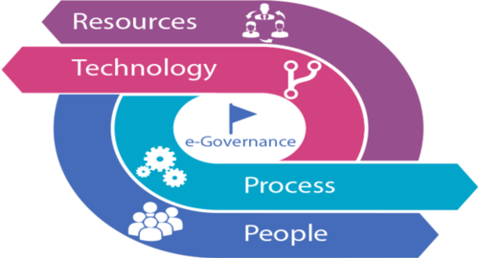

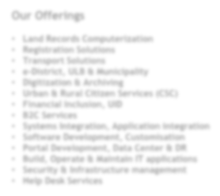

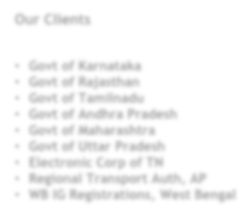
E-Governance Solutions
Our ICT projects have created thousands of employment opportunities, facilitated the implementation of various government policies and brought in large numbers of citizens into the formal economy.
Leaders & pioneers in E-Governance with 30+ years of experience.
Citizen Services delivered to the last mile. Presence across 100,000+ villages
Facilitate 1.8 Mn Electronic transactions monthly.
Expertise across various financial models, Operations & Management
Supports Revenue, Social programs, Ease of Doing business, Bringing Transparency and Public Safety initiatives of Government.
Our Offerings
Land Records Computerization
Registration Solutions
Transport Solutions
e-District, ULB & Municipality
Digitization & Archiving
Urban & Rural Citizen Services (CSC)
Financial Inclusion, UID
B2C Services
Systems Integration, Application integration
Software Development, Customisation
Portal Development, Data Center & DR
Build, Operate & Maintain IT applications
Security & Infrastructure management
Help Desk Services
Our Clients
Govt of Karnataka
Govt of Rajasthan
Govt of Tamilnadu
Govt of Andhra Pradesh
Govt of Maharashtra
Govt of Uttar Pradesh
Electronic Corp of TN
Regional Transport Auth, AP
WB IG Registrations, West Bengal
Employees State Insurance ESIC
Punjab Land Records
CCTNS, Rajasthan
MGNREGA
Tripura PDS
Commercial Tax, AP
Warehouse Dev Regulatory Auth
VISA
Bharat Sanchar Nigam

Slide 9







CMS E-Governance Solutions
Integrated Citizen Services
e-District solutions
Digital Transformation
Solutions in Land records
Registration of document
Transport Department Solutions
Solution for Judicial System
Dairy Management System
Solutions for Police Department
FMS, Manpower, IT Support etc
G2C & B2C
Service Delivery
Deployment Services
Software &
Services
Operation & Management
System
Integration
Customer Support Services

Slide 10














CMS has the capability for Seamless Integration across the Ecosystem
Traffic Engg + IoT + Software + IT Infra
Traffic Advanced Transport Management Management & ICCC & TIMS
Enforcement & Access Control
Mobility Layers
Citizen Portals & App
SYSTEMS INTEGRATION
ENABLING TECHNOLOGIES
Technologies and platform that operate across nodes, enabling efficient customer use of the traffic network with ease of administration
CMS Computers seamless integration capabilities across Traffic, Software, IT and IoT as well as deep field expertise, is able to efficiently manage key traffic nodes, connecting multimodal networks and leveraging technological innovation to provide distinctive added- value service for the smoothest traffic.
Smart Parking
Connected Cars & EV Metering
E-mobility
Environment Monitoring
TRAFFIC MANAGEMENT
Connections among nodes centrally managed through enforcement and Traffic Information system wrapped around with Integrated Command and Control.
SUSTAINABLE NODES
Central Business Districts
Industrial Corridors
Highways
High Speed
Rail
Rail Connection
Centers of traffic generation including interchanges, corridors, Business Districts, VIP zones which may encompass their immediate surroundings
Parking spots
Airport
Waterway

Slide 11

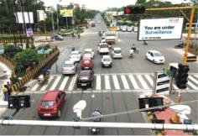
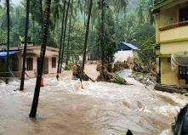
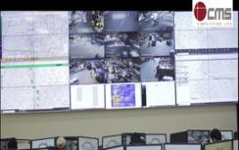


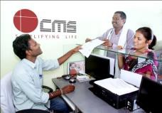
CMS Smart City & Public Safety Solutions
CMS can help:
Improve Traffic Management, Optimize Road Capacity & Enhance Travel experience.
Predict, Monitor, help mitigate Crisis through Early Warning & Real Time alerts as well as crowd management
Provide Operational Support to Citywide & Campus-wide Surveillance and management
Integration of all Physical & IT City/Campus
assets
Improve Citizen Experience through Service Delivery, Citizen Portals & Engagement apps
Co-ordinate Multi agency Responses and alerts
IT Datacenter & DR systems with Information
Security & Compliance management
Provide optimized visualization of key events
Automated management reporting and trend analysis
Intelligent Transportation & Traffic Management
Integrated Traffic Management (ITMS), Area Traffic Control
Products – UCON, GCDT, VMS, IP PA, ECB, Parking Meters
Software – Traffview, Traffvision, NeatPark, ECB/PA SW
Analytics & Computer Vision, RLVD, ANPR, Enforcement
Public Safety Applications
Citywide Surveillance & Operations, Junction Surveillance
Emergency Response Systems
Video Correlation & Analysis for Crime / Investigation, CCTNS
Early Warning, RealTime Alerts with Computer Aided Despatch
Integrated Command Control & City Dashboards
Heterogenous Data Collection & Integration
Cross Agency Collaboration, Incident management with KPI’s
Integrated System Monitoring & Visualizations
Datacenter, Cloud & Information Security Services
Smart Campus
Campus-wide Surveillance & Energy Monitoring/Smart Grid
RFID based Access Control & Intrusion Detection Systems
Asset Tracking & Parking Management
Workforce Management & Front Office Digital Lounge
Citizen Experience
Electronic Delivery of Citizen Services
Citizen Portal & Engagement Platform
Workflow and Crowd Sourcing applications
Single Window – Ease of Doing business Services

Slide 12







Energy & Utilities Solutions
Power Generation
Driving operational excellence in Generation Companies. Asset Utilisation.
Smart Distribution
Leveraging Smart Grid technologies for agility and higher profitability
Townships & Consumer
Deliver personalized customer experience & give stakeholders more control of their energy sources and usage.
Connected Intelligence Solutions
Capture opportunities across Value Chain through Digital Transformation leveraging Information flows – Asset Management, Plant Maintenance, Blockchain.
Agile IT
Real time available, scalable systems spanning IT & IoT technologies using Computing Infrastructures and Cloud.

Slide 13
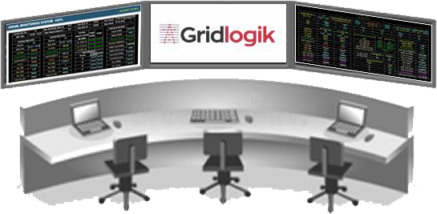













CMS End to End Smart Grid Solution
Integrated Command Control
CMS GridLogik Servers
MPLS
DATA CENTER
GIS
Billing & CRM
GPRS
Over DLMS Protocol
GPRS
Over DLMS Protocol
CMS DCU
CMS DCU
CMS DCU
GPRS
Over DLMS Protocol
RF
RF
RF
OFFICE COMPLEX
Single Phase Smart Meter
FACTORY / CAMPUS
Three Phase Smart Meter
RESIDENTIAL
Single Phase Smart Meter

Slide 14
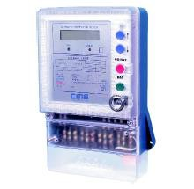
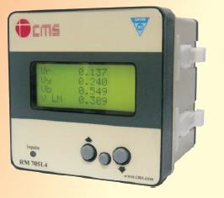

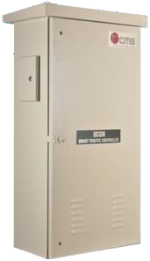
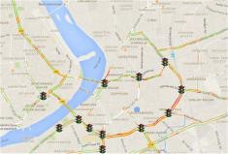
CMS Hardware & Software IP/Assets
Software Assets
KAWACH Disaster Management System
SARVA ERP System – Back Office
Digital Lounge – Front Office
Case Watch System for Judiciary Tribunals
eDistrict Citizen Services platform
Reach my India (RMI) B2B Service Portal
GridLogik Energy Platform
DciFER Energy Forecasting
CityView Command Control Center (ICCC)
Traffview Area Traffic Control Platform
TraffVision AI/ML Vehicular Classification
NeatPark Parking management
UNO & mUNO Workforce Management
Indigenous Hardware Assets
Traffic signalling AC & DC UCON Controllers
LED aspects (Dot matrix and Central source)
Count Down Timers, Variable Messaging Signs ECB & PA Public Safety Systems
ABT Energy meters,
Smart Meters & Data Concentrators

Slide 15



CMS Software & IT Services Solutions
Support Current Infrastructure
Enable Digital Transformation
Create Client
Value
Scalable Computing Legacy Support
Application Maintenance Services
Compliance
Cloud Transition / Migration
On-Premise + Cloud Integration
Application Modernization Enabled Information
Security
IT-IoT Integration
Big Data Analytics / Machine Learning
Domain / IP based Solutions
Automation
SLA based Services

Slide 16




IT Services – Practices
Cloud
Services
End –to End Services
Diversified and Vendor/OEM neutral
Constant Assessment & Roadmap dev.
Infra Consolidation/ Optimization
Quick provisioning / Automation
Flexible Service Delivery models
Strong Alliance /Partnerships
ITIL Compliance
Data Center
Services
End User Services *
Information Security Services

Slide 17

























Our Strengths in IT Services
IT Landscape
Customers
People
Pan-India Presence
8000+ Servers
30 PB+ of Enterprise storage & Backup
4000 + Routers
10000+ Core, Dist. & Access Switches
600+ Security Devices , firewalls, IPS/IDS etc
3400+ IT resources
20/58/22 % of L1/L2/L3 split
70% of the resources are certified in their Tech domain
90% Retention
140+ Customers
Very large to SMB
Government
Public Sector
Enterprise
14 Offices across india
Metros
Key State Capitals
100+ support locations –with resident engineers
35,000 franchisee locations

Slide 18
DC Integrated Service Delivery
Consulting/ Engineering / Architecture Services
Build/Migrate/Upgrade ( DC Transformation) Services
Platform Services
Storage Services
Backup/Recovery
/DR Services
DC Network/
Security Services
Database management Services
Middleware
Services
Application Management Services
24/7 Monitoring & DC Operations Services
Infra mgmt tools & Service Management (ITSM) Services
24/7 DC Building Management Services
24/7 Physical Security & housekeeping services
Alliance & Partnerships with Leading OEM/Vendors

Slide 19
Information Security system for clients
Data Protection, Encryption
Degaussing, DRM
DevOps Security
Application scanning
App Security Mgt
DATA
Access Control
Privileged user management
Identity governance & Admn
Access management/ IDaas
IDENTITY & ACCESS
APPS
Vulnerability management Anomaly detection Incident Response
Workload Protection
Access Security Broker
SECURITY ORCHESTRATION & ANALYTICS
Fraud protection
Crime detection
CLOUD
ADVANCED FRAUD
Endpoint patch & Controls
Malware protection
Mobile Txn protection
BYOD & Content security
Security Consulting Compliance Certifications
Firewalls, Filters and IPS
NW forensics & Threat Mgt
Network Visibility
ENDPOINT
NETWORK
Mgd Security
& Services
VA & PT
Log & Flow Analysis
Security Mgt & Intelligence

Slide 20








CMS in Software: CMMI Level 5 Maturity
Product Dev Centres at Thiruvananthapuram & Mumbai
Software Dev Centres at Bengaluru, Hyderabad & Chennai
Analytics CoE at Bengaluru; Energy COE at Mumbai
Resource Capabilities | Strength
Project & Service Management | 35
Java | 120
Portal Technologies | 80
Dot Net | 72
Mobile & UI | 55
Business Analyst, Quality, Others | 85
Database Developers & Admin | 60
Embedded Technologies | 50
Data Science (Analytics, Python, R) | 25
System Admin | 32
Support Engineers | 300+
Robust Governance Model
Lower Operating Cost
Providing Customers with a Robust Governance Model to manage new developments, BAU support, enhancements & new features
Flexible Cost Models to enable reduction of TCO on Software (Ticket Volume, Delivery Locations & Coverage)
Innovation
Tools & Frameworks
Innovation based on Proof Of Concept and Proof of Value approach with high efficiency and minimum disruption
Use of CMS proprietary Tools and Frameworks to enhance productivity and better speed to market

Slide 21
CMS Software Capabilities
We provide high quality Software Solutions and Services with key focus on Application Management in the area of Digital Services, Bespoke and Open-source technologies
• eGovernance Services
Enterprise Solutions
Custom ERP Implementation
Managed Services
Enterprise Applications
Cloud Services
Hospital Management Systems
Consultancy Services
Health Insurance Solutions
Information Security
Analytics and Computer Vision Solutions
Digital Solutions

Slide 22








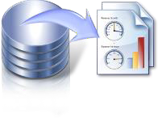






CMS Data Sciences and Analytics COE
CMS Data Science offers a holistic approach that turns data into insight and insight into business outcomes
Data Preparation: Preparation
and Cleaning of Client data
Modeling : Applying Ensemble ML Algorithms on the prepared Data to understand the Best Fit
Analyze & Cleanse Information of any Variety
Organize & Model Extreme Volumes of Information
Evaluation : Accuracy, Sensitivity, Specificity, F-Score, AUC, R-Sq, Adj R-SQ, RMSE
Analyze Information: Collection, Description and Exploration of Historical
data
Deployment : Different real time evaluation and A/B Testing to push to the PROD/Live data
Business Insight: Identifying the Client Analytical Goal based on resource and Constraints .
Identify Patterns and Discover Insights
Analyze Information in Motion
CRISP-DM
Framework
Manage deployment & Improve
Copyright © 2024 CMS Computers India Private Ltd. All Rights Reserved.

Slide 23












Client Service Delivery Framework
Service Management: DevOps, ITSM, ISO
Information Security Controls & remediation
Centralized Service Desk
Asset Lifecycle Management
Vendor Management
PMO Led Governance
Infrastructure / Applications Monitoring & Management
Quality Management
Software Support & Extensions
IT & IoT Device Support Spares Management
LLD / HLD
Implementation
Roll Out / Harvesting
Consulting
Requirements Analysis & FRS / SRS

Slide 24
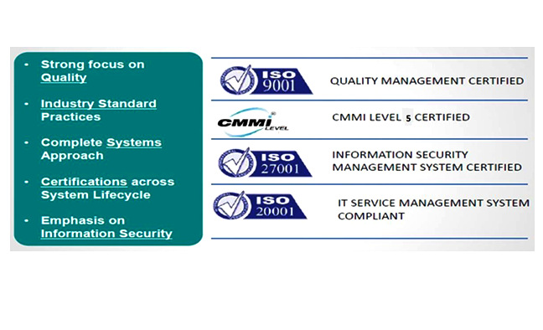
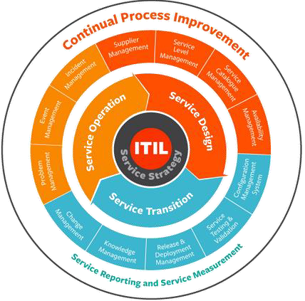
Client Services : Adherence to Standards
We follow ITIL Processes and Best Practices using Industry Standard ITSM tools to provide Service Desk and Service Management services

Slide 25






CMS Value Proposition
The combined experience of multiple engagements in chosen domains plus Deep expertise
in Operations, IT, IoT, Software and Digital Technologies delivers differentiated value.
Vast Experienceof over45+yearsof Project Management, currently running100+liveprojectsacrossthecountry. ExtensiveExperiencein eGovernance, Traffic, Smart CityandEnergy withover500+client engagements.
Deep Operationsexperience running several government programsover 25+years. Ground level experience runningSmart City, City Surveillance, Energy management projects, deliveringCitizenServicesandDigital transformations..
Expertise combining Hardware, Firmware, Software, Middleware integrating IT & IoT technologiesacrossindustry domains. Internal Product development andownIPensuresflexibilityinmeetinguserrequirements.
Avendor-neutral, collaborative approach toproject management bringing best practicesacross Implementation, Integration & Customizationdeliveringbusinessvaluehasensuredsuccessacrossprojectsundertaken.
MultipleLongtermdrivers, strongannuity basedvisibility andcontinuoustrack recordof profitability ensuresproject executionwithout frequent disruption.

Slide 26


